Slide 1


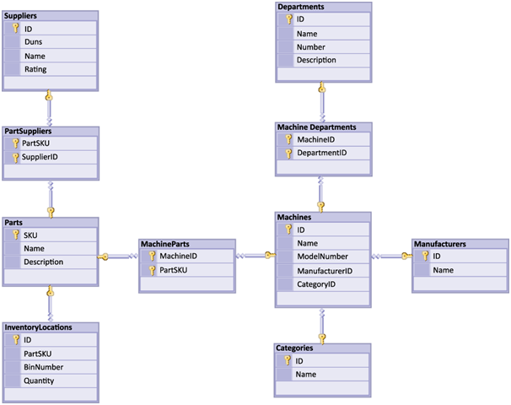


Table Relations
Database Design and Rules
Table
Relations
SoftUni Team
Technical Trainers
Software University
http://softuni.bg

Slide 2
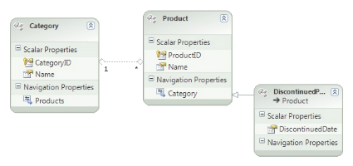




Table of Content
Database Design
Table Relations
Cascade Operations
E/R Diagrams

Slide 3
Questions
sli.do #MYSQL

Slide 4

Database Design
Fundamental Concepts

Slide 5

Steps in Database Design
Steps in the database design process:
Identification of the entities
Identification of the columns in the tables
Defining a primary key for each entity table
Identification and modeling of relationships
Multiplicity of relationships
Defining other constraints
Filling test data in the tables

Slide 6
Identification of Entities
Entity tables represent objects from the real world
Most often they are nouns in the specification
For example:
Entities: Student, Course, Town
We need to develop a system that stores information about students, which are trained in various courses. The courses are held in different towns. When registering a new student the following information is entered: name, faculty number, photo and date.

Slide 7
Identification of the Columns
Columns are clarifications for the entities in the text of the specification, for example:
Students have the following characteristics:
Name, faculty number, photo, date of enlistment and a list of courses they visit
We need to develop a system that stores information about students, which are trained in various courses. The courses are held in different towns. When registering a new student the following information is entered: name, faculty number, photo and date.

Slide 8
How to Choose a Primary Key?
Always define an additional column for the primary key
Don't use an existing column (for example SSN)
Must be an integer number
Must be declared as a primary key
Use auto_increment to implement auto-increment
Put the primary key as a first column
Exceptions
Entities that have well known ID, e.g. countries (BG, DE, US) and currencies (USD, EUR, BGN)

Slide 9
Identification of Relationships
Relationships are dependencies between the entities:
"Students are trained in courses" – many-to-many relationship.
We need to develop a system that stores information about students, which are trained in various courses. The courses are held in different towns. When registering a new student the following information is entered: name, faculty number, photo and date.

Slide 10
Identification of Relationships
Relationships are dependencies between the entities:
"Students are trained in courses" – many-to-many relationship.
"Courses are held in towns" – many-to-one (or many-to-many) relationship
We need to develop a system that stores information about students, which are trained in various courses. The courses are held in different towns. When registering a new student the following information is entered: name, faculty number, photo and date.

Slide 11



Table Relations
Relational Database Model in Action

Slide 12
Relationships
Relationships between tables are based on interconnections: primary key / foreign key
Primary key
Foreign key
towns
Primary key
countries
id | name | country_id
1 | Sofia | 1
2 | Varna | 1
3 | Munich | 2
4 | Berlin | 2
5 | Moscow | 3
id | name
1 | Bulgaria
2 | Germany
3 | Russia
Relationship

Slide 13
Relationships (2)
The foreign key is an identifier of a record located in another table (usually its primary key)
By using relationships we avoid repeating data in the database
In the last example the name of the country is not repeated for each town (its number is used instead)
Relationships have multiplicity:
One-to-many – e.g. country / towns
Many-to-many – e.g. student / course
One-to-one – e.g. example driver / car

Slide 14
One-to-Many/Many-to-One
Primary key
Primary key
Foreign key
Mountains
Peaks
mountain_id | name
5 | Caucasus
peak_id | mountain_id
61 | 5
66 | 5
Relation
Notes:
One-to-Many relationship means that each row from a table is related zero, one or many rows in the referent table. In the case above, each mountain can have 0, 1 or many peaks. The example shows that the mountain Caucasus has two peaks - One-to-Many. If you look the other way around many peaks has exactly one mountain – Many-to-One.

Slide 15
Setup
Primary key
CREATE TABLE mountains(
mountain_id INT PRIMARY KEY,
mountain_name VARCHAR(50)
);
CREATE TABLE peaks(
peak_id INT PRIMARY KEY,
mountain_id INT,
CONSTRAINT fk_peaks_mountains
FOREIGN KEY (mountain_id) REFERENCES mountains(mountain_id) );
Table Peaks
Foreign Key

Slide 16
Foreign Key
Constraint Name
CONSTRAINT fk_peaks_mountains FOREIGN KEY (mountain_id) REFERENCES mountains(mountain_id);
Foreign Key
Referent Table
Primary Key

Slide 17
Many-to-Many
Primary key
Primary key
employees
projects
employee_id | employee_name
1 | …
40 | …
project_id | project_name
4 | ..
24 | …
Mapping table
employees_projects
employee_id | project_id
1 | 4
1 | 24
40 | 24
Notes:
Many-to-Many relationship relates many rows from a table to many rows in another table. For example. Employee.EmployeeID has many projects. Many projects are assigned to many employees which is the other way around. Usually we have a mapping table that takes care of the relations.

Slide 18
Setup(1)
CREATE TABLE employees(
employee_id INT PRIMARY KEY, employee_name VARCHAR(50)
);
Table Employees
CREATE TABLE projects( project_id INT PRIMARY KEY, project_name VARCHAR(50)
);
Table Projects

Slide 19
Setup(2)
Table EmployeesProjects
CREATE TABLE employees_projects( employee_id INT, project_id INT,
CONSTRAINT pk_employees_projects
PRIMARY KEY(employee_id, project_id),
CONSTRAINT fk_employees_projects_employees
FOREIGN KEY(employee_id)
REFERENCES employees(employee_id),
CONSTRAINT fk_employees_projects_projects
FOREIGN KEY(project_id)
REFERENCES projects(project_id)
);
Primary Key
Foreign Key
Foreign Key

Slide 20
One-to-One
Primary key
Primary key
Foreign key
cars
drivers
car_id | driver_id
1 | 166
2 | 102
driver_id | driver_name
166 | ..
102 | …
Relation
Notes:
In One-to-One relationship each row of table Cars is related to exactly zero or one row in table Drivers. In table Cars.DriverID is a foreign key which means that there will be a relation to another table – Drivers in the case. Table Drivers has a column DriverID as well which is a primary key. The relation is always between a foreign key and a primary key. It means that all values in Cars.DriverID should be present in Drivers. DriverID except NULL. Cars.DriverID can be NULL if it is not stated otherwise.

Slide 21
Setup
Primary key
CREATE TABLE drivers(
driver_id INT PRIMARY KEY,
driver_name VARCHAR(50)
);
CREATE TABLE cars(
car_id INT PRIMARY KEY,
driver_id INT UNIQUE,
CONSTRAINT fk_cars_drivers FOREIGN KEY (driver_id) REFERENCES drivers(driver_id)
);
One driver
per car
Foreign Key

Slide 22
Foreign Key
Constraint Name
CONSTRAINT fk_cars_drivers FOREIGN KEY (driver_id) REFERENCES drivers(driver_id)
Foreign Key
Referent Table
Primary Key

Slide 23
Retrieving Related Data
Table 1
Table 2
Using Simple JOIN statements

Slide 24
Joins
Table relations are useful when combined with JOINS. With JOINS we can get data from two tables simultaneously.
JOINS require at least two tables and a "join condition".
Example:
Select from Tables
SELECT * FROM table_a JOIN table_b ON table_b.common_column = table_a.common_column
Join Condition

Slide 25
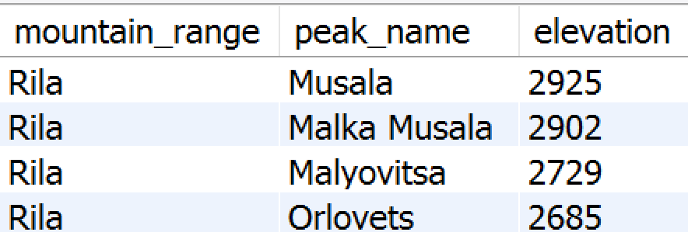
Problem: Peaks in Rila
Use database "Geography". Report all peaks for "Rila" mountain.
Report includes mountain's name, peak's name and also peak's elevation.
Peaks should be sorted by elevation descending.
Check your solution here: https://judge.softuni.bg/Contests/Practice/Index/605#6

Slide 26
Solution: Peaks in Rila
Cross Table Selection
SELECT m.mountain_range, p.peak_name, p.elevation
FROM peaks AS p
JOIN mountains AS m ON m.id = p.mountain_id
WHERE m.mountain_range = 'Rila' ORDER BY p.elevation DESC;
Join Condition
Sort
Check your solution here: https://judge.softuni.bg/Contests/Practice/Index/605#6

Slide 27

Cascade Operations
Cascade Delete/Update

Slide 28
Definition
Cascading allows when a change is made to certain entity, this change to apply to all related entities.
Primary key
Foreign key
Primary key
orders
order_items
оrder_id | order_name
1 | …
22 | …
item_id | order_id
4 | 1
24 | 22
87 | 1
Cascade delete

Slide 29
Cascade Delete
Cascade can be either Delete or Update.
Use Cascade Delete when:
The related entities are meaningless without the "main" one
Do not use Cascade Delete when:
You make "logical delete"
You preserve history
Keep in mind that in more complicated relations it won't work with circular references

Slide 30
Cascade Update
Use Cascade Update when:
The primary key is not identity (not auto-increment) and therefore it can be changed
Best used with unique constraint
Do not use Cascade Update when:
The primary is identity (auto-increment)
Cascading can be avoided using triggers or procedures.

Slide 31
Foreign Key Delete Cascade
Table Drivers
CREATE TABLE drivers(
driver_id INT PRIMARY KEY,
driver_name VARCHAR(50)
);
CREATE TABLE cars(
car_id INT PRIMARY KEY,
driver_id INT,
CONSTRAINT fk_car_driver FOREIGN KEY(driver_id)
REFERENCES drivers(driver_id) ON DELETE CASCADE );
Table Cars
Foreign Key
Cascade

Slide 32
Foreign Key Update Cascade
Table Drivers
CREATE TABLE drivers(
driver_id INT PRIMARY KEY,
driver_name VARCHAR(50)
);
CREATE TABLE cars(
car_id INT PRIMARY KEY,
driver_id INT,
CONSTRAINT fk_car_driver FOREIGN KEY(driver_id)
REFERENCES drivers(driver_id) ON UPDATE CASCADE );
Table Cars
Foreign Key
Cascade

Slide 33
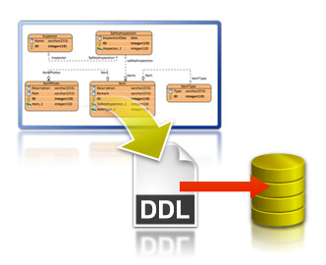
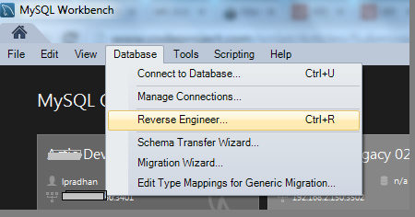
E/R Diagrams
Entity / Relationship Diagrams
Notes:
E/R diagrams represent the tables which are called entities and the relationships between them. They are used as a technical illustration of the database design.
To Do: snip how to create e/r diagram.

Slide 34
Relational Schema
Relational schema of a DB is the collection of:
The schemas of all tables
Relationships between the tables
Any other database objects (e.g. constraints)
The relational schema describes the structure of the database
Doesn't contain data, but metadata
Relational schemas are graphically displayed in Entity / Relationship diagrams (E/R Diagrams)

Slide 35
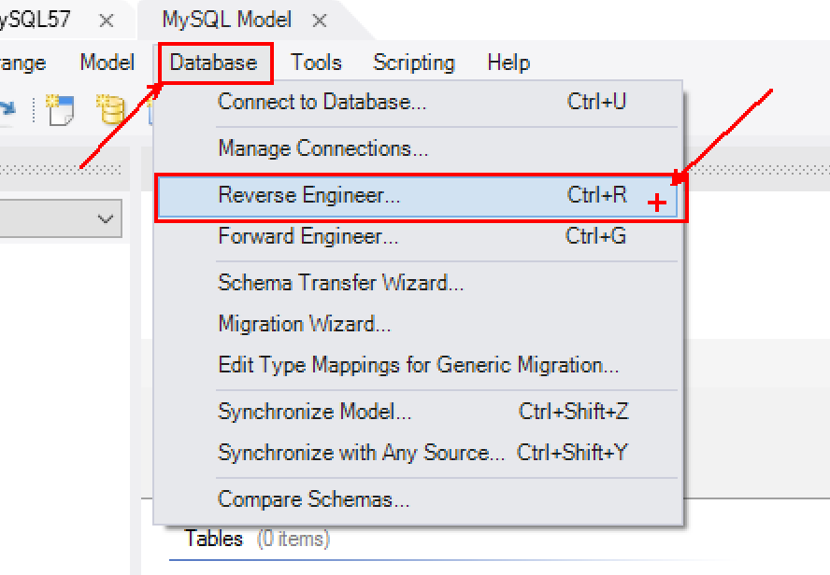
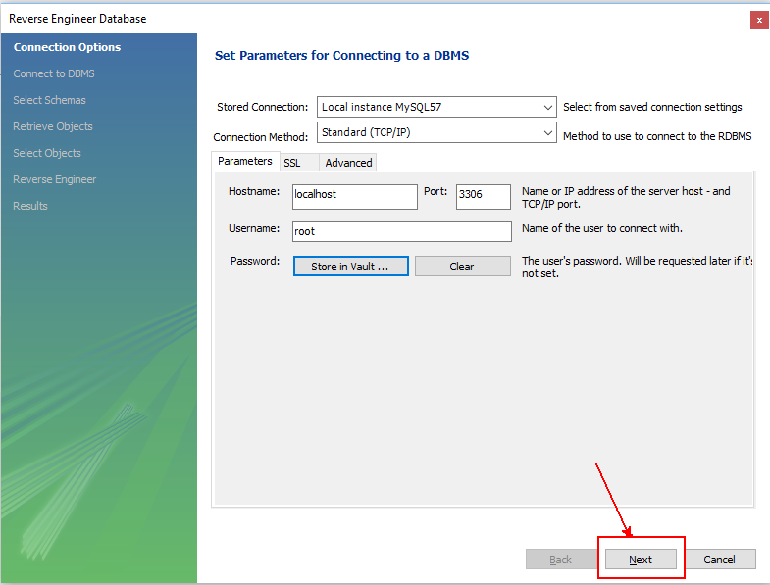
E/R Diagram
Click on "Database" then select "Reverse Engineer"

Slide 36
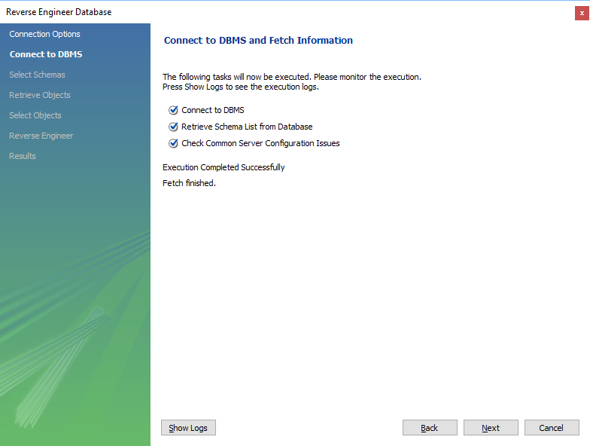
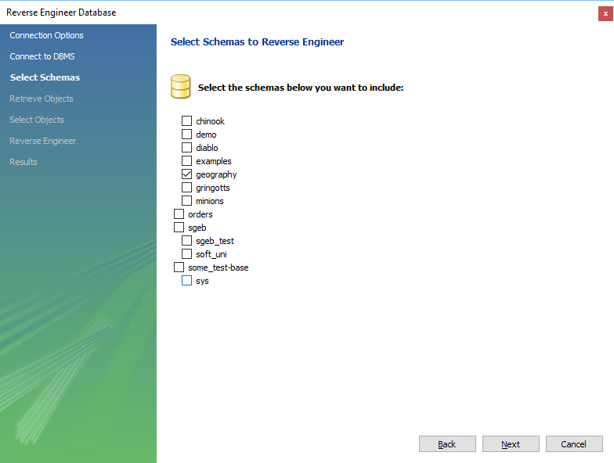
E/R Diagram

Slide 37
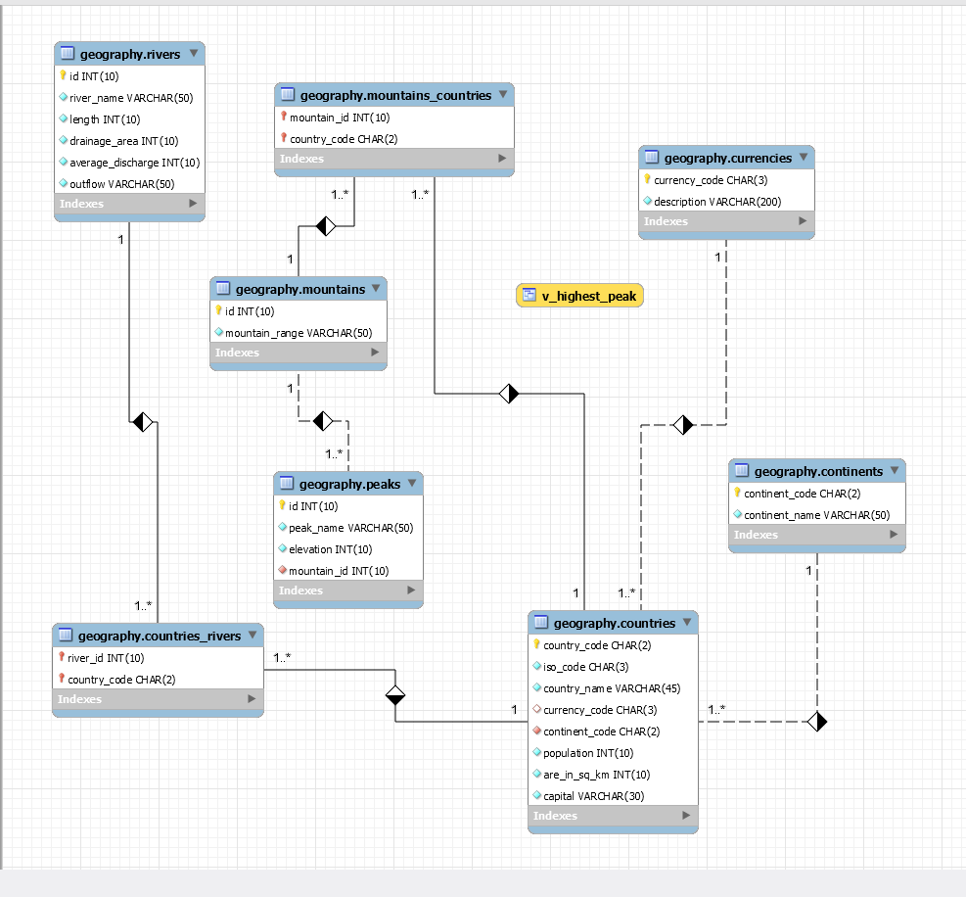
E/R Diagram

Slide 38



Summary
How to design a database?
What are the types of table relations?
Cascading – pros and cons?
How can we visualize all of our relations in database ?
Databases

Slide 39







Table Relations
https://softuni.bg/trainings/

Slide 40
License
This course (slides, examples, demos, videos, homework, etc.) is licensed under the "Creative Commons Attribution-NonCommercial-ShareAlike 4.0 International" license
Attribution: this work may contain portions from
"Databases" course by Telerik Academy under CC-BY-NC-SA license

Slide 41




Free Trainings @ Software University
Software University Foundation – softuni.org
Software University – High-Quality Education, Profession and Job for Software Developers
softuni.bg
Software University @ Facebook
facebook.com/SoftwareUniversity
Software University Forums
forum.softuni.bg

